Slide 1
UPPER SIXTH ARTS
GEOGRAPHY
Further Study 4: Management of Water Resources in Cameroon
Management of Water Resources in Cameroon
Notes:
Good morning, class, and welcome to our geography lesson. I am your geography teacher, Mr Kamdem. Today we are starting Further Study 4: Management of Water Resources in Cameroon.

Slide 2
CLASS INFO
Class, Chapter and Duration
Class | Upper Sixth Arts
Chapter | Module 6: Understanding and managing the dynamics of economic activities across the world in general and Cameroon in particular
Duration | 2 periods (2 × 50 minutes)
Notes:
This lesson is for Upper Sixth Arts. It belongs to Module 6: Understanding and managing the dynamics of economic activities across the world in general and Cameroon in particular. We shall need 2 periods to cover it.

Slide 3
IDENTIFICATION
Lesson Identification
Topic | Geography of Cameroon
Sub-topic | Water Resources of Cameroon
Lesson | Further Study 4: Management of Water Resources in Cameroon
Notions / Concepts | Water resources, fishing, aquaculture, irrigation, flood-retreat farming, hydro-electricity, SEMRY, UNVDA.
Syllabus focus | Distribution of water bodies and their resources and uses; fishing (modern and traditional), problems and impacts; irrigation schemes, benefits and problems.
Competence | Learners are able to describe how Cameroon uses its water resources and propose improvements.
Notes:
Our topic is Geography of Cameroon, and the sub-topic is Water Resources of Cameroon. The key notions we shall use today are: water resources, fishing, aquaculture, irrigation, flood-retreat farming, hydro-electricity, SEMRY, UNVDA. At the end, you should be able to do this: learners are able to describe how Cameroon uses its water resources and propose improvements.

Slide 4

HOMEWORK CORRECTION
Correction of the Homework
Question (Further Study 3: Management of Mineral and Energy Resources in Cameroon):
Draw the mineral map of Cameroon.
Notes:
Before we start the new lesson, let us correct the homework I gave you at the end of Further Study 3: Management of Mineral and Energy Resources in Cameroon. The question was: Draw the mineral map of Cameroon. Take out your exercise books.

Slide 5
HOMEWORK CORRECTION
Correction: Possible Answer
Map: oil – Rio del Rey and Kribi offshore; gas – Kribi; bauxite – Minim-Martap and Fongo-Tongo; iron ore – Mbalam and Lolodorf; gold – East (Batouri, Bétaré-Oya); cobalt – Lomié; limestone – Figuil.
Notes:
Here is a good answer. Map: oil – Rio del Rey and Kribi offshore; gas – Kribi; bauxite – Minim-Martap and Fongo-Tongo; iron ore – Mbalam and Lolodorf; gold – East (Batouri, Bétaré-Oya); cobalt – Lomié; limestone – Figuil. Compare it with your own answer and correct your work in red.

Slide 6
LESSON PLAN
Lesson Plan
Correction of the homework
Objectives and recall
Real-life situation and action to take
Learning activities
Board summary
Evaluation, remediation and homework
Notes:
Here is the plan of our lesson today. First, we shall correct the homework. Then we shall look at the objectives and recall what you already know. After that, we shall study a situation from real life and the action to take, and do the learning activities. Finally, we shall copy the board summary, do the evaluation and the remediation, and I will give you the homework.

Slide 7
OBJECTIVES
Objectives
By the end of this lesson, you should be able to:
Describe the water bodies of Cameroon and their uses.
Explain fishing and its problems.
Notes:
Take your time to copy this part; we will continue together.

Slide 8
OBJECTIVES
Objectives (continued)
Explain irrigation schemes, their benefits and problems.
Notes:
By the end of this lesson, you should be able to do three things. Number 1: describe the water bodies of Cameroon and their uses. Number 2: explain fishing and its problems. Number 3: explain irrigation schemes, their benefits and problems.

Slide 9
PREVIOUS KNOWLEDGE
Previous Knowledge
Cameroon has four drainage basins.
Dams produce hydro-electricity.
Notes:
Let us first remember what you already know. Cameroon has four drainage basins. Dams produce hydro-electricity. Keep this in mind, because we shall build on it today.

Slide 10
REAL-LIFE SITUATION
Situation in Real Life
Around Yagoua, SEMRY grows irrigated rice with water from the Logone. On Lake Lagdo and the coast, fishermen catch fish for the markets. The Lom Pangar dam regulates the Sanaga for electricity.
Notes:
Listen carefully to this situation from real life. Around Yagoua, SEMRY grows irrigated rice with water from the Logone. On Lake Lagdo and the coast, fishermen catch fish for the markets. The Lom Pangar dam regulates the Sanaga for electricity. Think about it, because I am going to ask you some questions.

Slide 11
REAL-LIFE SITUATION
Situation: Question 1
What is the problem in the situation?
Notes:
Question 1: What is the problem in the situation? Think for a moment, then raise your hand to answer.

Slide 12
REAL-LIFE SITUATION
Answer
Water is used in many ways.
Notes:
Good. Water is used in many ways.

Slide 13
REAL-LIFE SITUATION
Situation: Question 2
Name three uses of water in the situation.
Notes:
Question 2: Name three uses of water in the situation. Think for a moment, then raise your hand to answer.

Slide 14
REAL-LIFE SITUATION
Answer
Irrigation, fishing and electricity.
Notes:
Good. Irrigation, fishing and electricity.

Slide 15
REAL-LIFE SITUATION
Situation: Question 3
What is SEMRY?
Notes:
Question 3: What is SEMRY? Think for a moment, then raise your hand to answer.

Slide 16
REAL-LIFE SITUATION
Possible Answer
A state rice irrigation company in the Far North.
Notes:
Good. A state rice irrigation company in the Far North.

Slide 17
ACTION TO TAKE
Action to Take
Manage water resources for energy, food and health.
Notes:
From this situation, the action we are working towards in this lesson is the following: manage water resources for energy, food and health.

Slide 18
JUSTIFICATION
Justification of the Lesson
This further study helps us to use the water resources of Cameroon wisely.
Notes:
Why is this lesson important for you? This further study helps us to use the water resources of Cameroon wisely.

Slide 19
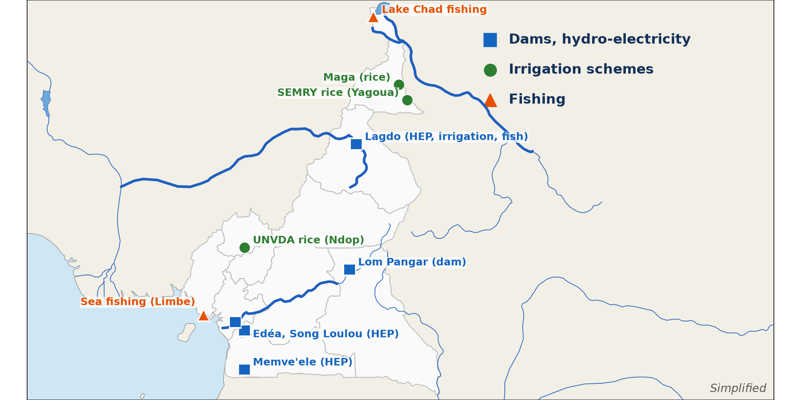
1. DISTRIBUTION AND USES
Activity 1
Main water uses in Cameroon (simplified).
Notes:
Activity 1. Look carefully at this diagram: main water uses in Cameroon (simplified). Observe every detail before I ask the question.

Slide 20
1. DISTRIBUTION AND USES
Activity 1: Question
Name two dams and their uses.
Notes:
Here is the question for Activity 1: Name two dams and their uses. Take one minute to think and write your answer in your rough notebook.

Slide 21
1. DISTRIBUTION AND USES
Activity 1: Answer
Song Loulou (electricity) and Lagdo (electricity, irrigation, fishing).
Notes:
Let us check the answer together. Song Loulou (electricity) and Lagdo (electricity, irrigation, fishing).

Slide 22
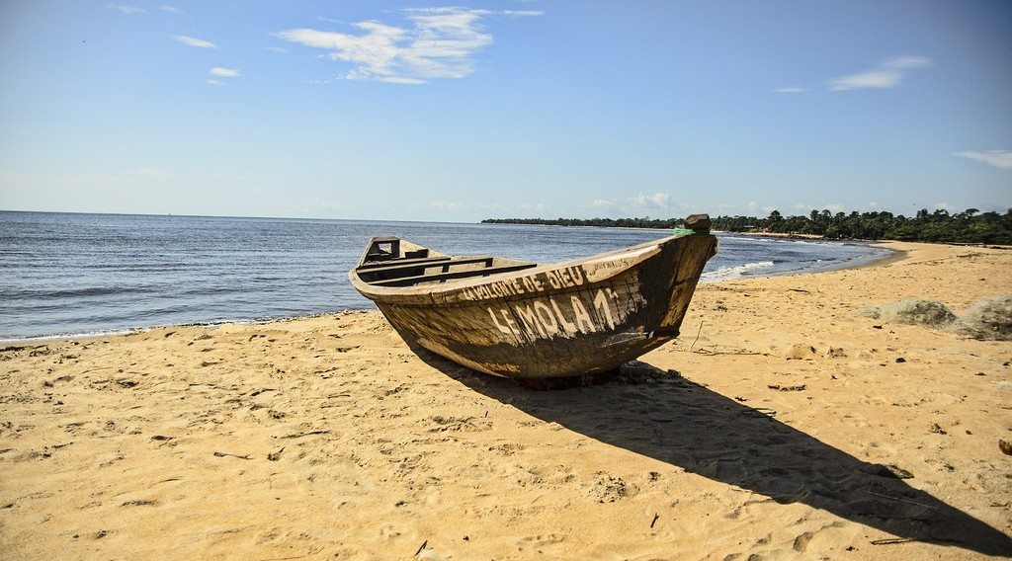
2. FISHING
Activity 2
Fishing boats.
Notes:
Activity 2. Look carefully at this picture: fishing boats. Observe every detail before I ask the question.

Slide 23
2. FISHING
Activity 2: Question
Distinguish traditional and modern fishing.
Notes:
Here is the question for Activity 2: Distinguish traditional and modern fishing. Take one minute to think and write your answer in your rough notebook.

Slide 24
2. FISHING
Activity 2: Answer
Traditional: canoes, nets, small catches. Modern: trawlers, cold storage, large catches.
Notes:
Let us check the answer together. Traditional: canoes, nets, small catches. Modern: trawlers, cold storage, large catches.

Slide 25

2. FISHING PROBLEMS
Activity 3
Lake Chad.
Notes:
Activity 3. Look carefully at this picture: lake Chad. Observe every detail before I ask the question.

Slide 26
2. FISHING PROBLEMS
Activity 3: Question
Give two problems of fishing in Cameroon.
Notes:
Here is the question for Activity 3: Give two problems of fishing in Cameroon. Take one minute to think and write your answer in your rough notebook.

Slide 27
2. FISHING PROBLEMS
Activity 3: Answer
Shrinking lakes and overfishing (also poor storage, insecurity).
Notes:
Let us check the answer together. Shrinking lakes and overfishing (also poor storage, insecurity).

Slide 28

3. IRRIGATION
Activity 4
Irrigated rice.
Notes:
Activity 4. Look carefully at this picture: irrigated rice. Observe every detail before I ask the question.

Slide 29
3. IRRIGATION
Activity 4: Question
Name two irrigation schemes and their crop.
Notes:
Here is the question for Activity 4: Name two irrigation schemes and their crop. Take one minute to think and write your answer in your rough notebook.

Slide 30
3. IRRIGATION
Activity 4: Answer
SEMRY (Yagoua, Maga) and UNVDA (Ndop): rice.
Notes:
Let us check the answer together. SEMRY (Yagoua, Maga) and UNVDA (Ndop): rice.

Slide 31

3. BENEFITS AND PROBLEMS
Activity 5
The Lagdo dam on the Benue.
Notes:
Activity 5. Look carefully at this picture: the Lagdo dam on the Benue. Observe every detail before I ask the question.

Slide 32
3. BENEFITS AND PROBLEMS
Activity 5: Question
Give one benefit and one problem of irrigation schemes.
Notes:
Here is the question for Activity 5: Give one benefit and one problem of irrigation schemes. Take one minute to think and write your answer in your rough notebook.

Slide 33
3. BENEFITS AND PROBLEMS
Activity 5: Answer
Benefit: food and income all year. Problem: high costs, waterborne diseases, salinisation.
Notes:
Let us check the answer together. Benefit: food and income all year. Problem: high costs, waterborne diseases, salinisation.

Slide 34
BOARD SUMMARY
Board Summary
Topic: Geography of Cameroon
Sub-topic: Water Resources of Cameroon
Further Study 4: Management of Water Resources in Cameroon
Notes:
Now we are going to copy the board summary. Write the title and the headings neatly in your notebooks. I will give you enough time for each slide, so do not rush.

Slide 35
BOARD SUMMARY
1. Water Resources and their Uses
Cameroon has abundant water resources:
Resources: Large rivers (Sanaga, Benue, Logone, Nyong), lakes (Chad, Lagdo) and heavy rainfall in the south. Groundwater is important in the North.
Notes:
Let us copy Water Resources and their Uses. Cameroon has abundant water resources. On this slide we have Resources. Write each point on a new line, with the key term first, and explain it in your own words when we revise. When you finish, we go to the next slide.

Slide 36
BOARD SUMMARY
1. Water Resources and their Uses (continued)
Uses: Water is used for hydro-electricity (Edéa, Lagdo, Nachtigal), drinking, irrigation, fishing and transport. Dams also regulate river flow.
Notes:
We continue with Water Resources and their Uses. On this slide we have Uses. Write each point on a new line, with the key term first, and explain it in your own words when we revise.

Slide 37
BOARD SUMMARY
1. Water Resources and their Uses
Illustration: water resources of Cameroon
Notes:
Now draw this illustration in your notebook: water resources of Cameroon. Give it a title and label it clearly.

Slide 38
BOARD SUMMARY
2. Fishing
Fishing in Cameroon can be described as follows:
Types: Traditional (artisanal) fishing uses canoes and nets on the coast, rivers and lakes. Modern (industrial) fishing uses trawlers and cold storage from Douala and Kribi.
Notes:
Let us copy Fishing. Fishing in Cameroon can be described as follows. On this slide we have Types. Write each point on a new line, with the key term first, and explain it in your own words when we revise. When you finish, we go to the next slide.

Slide 39
BOARD SUMMARY
2. Fishing (continued)
Problems: Overfishing, pollution, the shrinking of Lake Chad and poor storage reduce catches. Foreign trawlers compete with local fishermen.
Notes:
We continue with Fishing. On this slide we have Problems. Write each point on a new line, with the key term first, and explain it in your own words when we revise.

Slide 40
BOARD SUMMARY
3. Irrigation and Management
Irrigation schemes and their management are as follows:
Irrigation schemes: SEMRY at Yagoua and Maga grows rice, and the Lagdo scheme grows rice and vegetables. UNVDA in Ndop grows rice.
Notes:
Let us copy Irrigation and Management. Irrigation schemes and their management are as follows. On this slide we have Irrigation schemes. Write each point on a new line, with the key term first, and explain it in your own words when we revise. When you finish, we go to the next slide.

Slide 41
BOARD SUMMARY
3. Irrigation and Management (continued)
Benefits and problems: Irrigation provides food and income all year. But schemes suffer from high costs, silting, water-borne diseases and poor maintenance.
Notes:
We continue with Irrigation and Management. On this slide we have Benefits and problems. Write each point on a new line, with the key term first, and explain it in your own words when we revise. When you finish, we go to the next slide.

Slide 42
BOARD SUMMARY
3. Irrigation and Management (continued)
Management: Integrated basin management, the Lake Chad Basin Commission and water laws aim to share and protect water. Clean water supply must reach rural areas.
Notes:
We continue with Irrigation and Management. On this slide we have Management. Write each point on a new line, with the key term first, and explain it in your own words when we revise.

Slide 43
FORMATIVE EVALUATION
Evaluation 1
Give three uses of water resources in Cameroon.
Notes:
Now let us check what you have understood. Question 1: Give three uses of water resources in Cameroon. Answer in your exercise book.

Slide 44
FORMATIVE EVALUATION
Expected Answer
Fishing, irrigation, electricity (also domestic use, transport).
Notes:
The expected answer is: fishing, irrigation, electricity (also domestic use, transport). If you got it right, well done.

Slide 45
FORMATIVE EVALUATION
Evaluation 2
Give two problems of irrigation schemes.
Notes:
Now let us check what you have understood. Question 2: Give two problems of irrigation schemes. Answer in your exercise book.

Slide 46
FORMATIVE EVALUATION
Expected Answer
High costs and waterborne diseases (also salinisation, poor maintenance).
Notes:
The expected answer is: high costs and waterborne diseases (also salinisation, poor maintenance). If you got it right, well done.

Slide 47
REMEDIATION
Remediation
Fill in the blanks:
SEMRY grows ______ at Yagoua.
UNVDA is at ______.
Song Loulou produces ______.
Notes:
For those who need more practice, fill in the blanks in your exercise book. The answers are: number 1, rice; number 2, Ndop; number 3, electricity.

Slide 48
HOMEWORK
Homework
Describe how water is used in your area.
Notes:
For your homework: Describe how water is used in your area. We shall correct it at the beginning of our next lesson.

Slide 49
NEXT LESSON
Next Lesson
Our next lesson will be on:
Lesson 14: What is Manufacturing?
Notes:
Our next lesson will be on Lesson 14: What is Manufacturing?. Thank you for your attention, and see you next time.

Slide 50
BILINGUAL GAME
Bilingual Game (Jeu Bilingue)
English | Français
Water resources | Les ressources en eau
Fishing | La pêche
Irrigation | L'irrigation
Dam | Le barrage
Fish farming | La pisciculture
Lake | Le lac
Notes:
Let us play the bilingual game. I say a word in English, and you give me the French word. Then we do the reverse.

Slide 51
LOGBOOK
Official Logbook (1/2)
Module / Topic | Geography of Cameroon
Lesson Title | Further Study 4: Management of Water Resources in Cameroon
Expected Learning Outcomes | Describe the water bodies of Cameroon and their uses. Explain fishing and its problems. Explain irrigation schemes, their benefits and problems.
Competence | Learners are able to describe how Cameroon uses its water resources and propose improvements.
Notes:
I record this information in the official logbook of the class after the lesson.

Slide 52
LOGBOOK
Official Logbook (2/2)
Matter Taught | Water Resources and their Uses; Fishing; Irrigation and Management.
Evaluation | Formative evaluation and remediation exercise.
Homework | Describe how water is used in your area.
Enrolment / Present / Absent | ____ / ____ / ____
Achievement | To be completed after the lesson.
Notes:
I complete the second page of the logbook: the matter taught, the evaluation, the homework and the attendance.

Slide 53
TEACHER'S NOTE
Teacher's Note
Timing: Homework correction, plan, objectives 8 min | Recall, situation, action 10 min | 5 activities 30 min | Board summary (copying) 30 min | Evaluation, remediation 10 min | Homework, next lesson 5 min | Logbook 7 min
Without the projector (Activity 1): draw the map.
Without the projector (Activity 2): describe fishing on the coast.
Without the projector (Activity 3): discuss Lake Chad.
Without the projector (Activity 4): find them on the map.
Without the projector (Activity 5): list benefits and problems.
Notes:
This slide is for me, the teacher: it gives the timing of the lesson and what to do if the projector is not available.

Slide 54
REFERENCES
References
National Geography Syllabus, MINESEC/IGE/IP-SS, 2019 — Module 6 (Economic Geography).
Photo, Activity 2: “Empty beaches” by ludwig.troller, CC BY-NC 2.0, via Flickr (https://www.flickr.com/photos/124845120@N03/14285811155)
Photo, Activity 3: “Lake Chad: almost gone” by GRIDArendal, CC BY-NC-SA 2.0, via Flickr (https://www.flickr.com/photos/148768555@N05/32323646926)
Photo, Activity 4: “A woman harvesting rice, Barotse floodplain, Zambia. Photo by Georgina” by WorldFish, CC BY-NC-ND 2.0, via Flickr (https://www.flickr.com/photos/61545321@N06/7848727138)
Photo, Activity 5: “South Holston Lake, (Virginia-Tennessee border, USA)” by James St. John, CC BY 2.0, via Flickr (https://www.flickr.com/photos/47445767@N05/39221734762)
Diagrams and animations: drawn for this lesson (Geography Department).
Notes:
These are the references and picture credits used to prepare this lesson.

